Slide 1

DEPARTMENT OF COMPUTER SCIENCE AND ENGINEERING
Professional Training - 1
ONLINE VIDEO GAME SALES PREDICTION
PROJECT STUDENT
S. Sai Krishna
42111098
PROJECT GUIDE
Dr. P.Sardar Maran Professor, CSE

Slide 2
AGENDA
Certificate
Introduction
Abstract
Objective
System Architecture / Ideation Map
Module Implementation
Results and Discussions
Conclusion
References

Slide 3
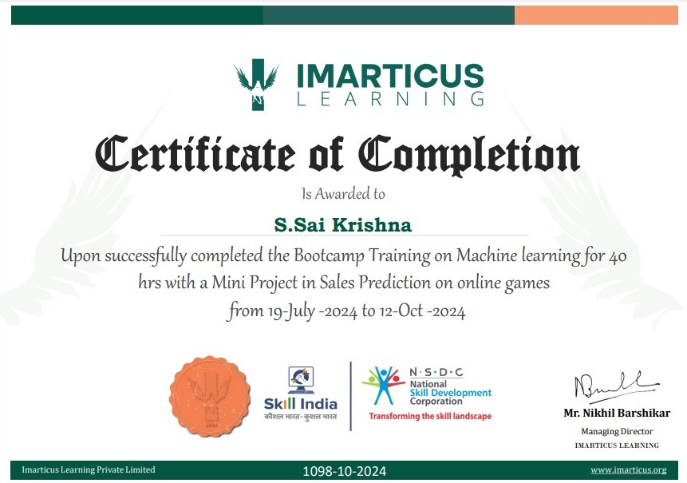
COURSE CERTIFICATE

Slide 4
INTRODUCTION
The video game industry has grown rapidly in recent years, driven by advancements in technology, the rise of online gaming, and an expanding player base. With this growth comes fierce competition, making it essential for companies to plan strategically to capture market share and maximize profitability. One of the critical aspects of strategic planning is the ability to accurately forecast future sales trends. This project focuses on using data analytics and machine learning to predict video game sales by analyzing key factors such as historical sales data, market trends, player demographics, and external influences like seasonal shifts or major game releases. By leveraging these predictions, gaming companies can make informed, data-driven decisions that enhance marketing strategies, optimize inventory, and improve overall resource allocation. Such insights not only offer a competitive edge but also help align production with market demand, ultimately boosting profitability.

Slide 5
ABSTRACT
This project explores the use of data analytics and machine learning to predict sales trends in the video game industry. With rapid industry growth and intense competition, accurate sales forecasting has become essential for game developers, publishers, and retailers to make data-driven decisions. The project leverages historical sales data, market trends, player demographics, and external factors such as seasonal variations and major game releases to build predictive models. Techniques like regression analysis, time series forecasting, and advanced machine learning algorithms are employed to develop reliable sales prediction models. These predictions enable companies to optimize marketing strategies, manage inventory, allocate resources, and improve budgeting, providing insights that guide strategic planning. By understanding anticipated demand, stakeholders can align their operations more closely with market trends, enhancing profitability and maintaining a competitive edge in the fast-paced gaming industry.

Slide 6
OBJECTIVE
The primary objective of this project is to develop a robust predictive model for forecasting video game sales, allowing stakeholders in the gaming industry to make informed, data-driven decisions. By analyzing historical sales data, player demographics, and external factors such as seasonal trends and new game releases, the project aims to:
Accurately predict future video game sales trends.
Support strategic decision-making in marketing, inventory management, and budget allocation.
Enable gaming companies to improve resource allocation and maximize profitability.
Provide insights into player preferences and market dynamics to inform future game development and promotional strategies.

Slide 7
LITERATURE SURVEY
1.Regression Models in Sales Prediction
Kotler and Armstrong (2018) highlighted the application of linear and multiple regression models in sales forecasting within retail sectors, including gaming. Their research demonstrates how sales are influenced by seasonal factors, marketing efforts, and product lifecycle stages, which can be applied to gaming sales forecasts.
Anderson and Simester (2019) studied predictive analytics for consumer behavior, including the role of demographic and seasonal data, showing that regression analysis can identify underlying trends in the gaming market.
2. Time Series Analysis for Video Game Sales
Wang et al. (2020) researched time series forecasting methods like ARIMA and SARIMA to predict retail sales. Their findings demonstrate the effectiveness of time series models in identifying seasonal patterns and sales peaks around holidays, which are critical in gaming sales prediction.
Friedman et al. (2021) explored SARIMA models applied to sales forecasting, emphasizing the importance of capturing seasonal cycles in predicting video game sales, especially around significant promotional events or game launches.

Slide 8
LITERATURE SURVEY
3.Machine Learning Approaches to Predict Game Sales
Mishra and Kalita (2019) introduced the use of machine learning techniques, such as decision trees and random forests, in the prediction of video game sales. Their research reveals that machine learning models can capture complex data patterns more effectively than traditional methods, improving prediction accuracy.
Li et al. (2020) studied neural networks and ensemble learning techniques for forecasting video game sales, finding that neural networks, despite their complexity, are capable of providing higher accuracy by learning intricate patterns across large datasets.
Tan and Zhang (2021) compared gradient boosting and random forests, showing that ensemble models outperform other machine learning algorithms by improving prediction accuracy in complex, data-rich environments like the gaming industry.
4. External Factors Impacting Sales
Kim et al. (2019) examined the influence of demographics, such as age and region, on video game sales, showing that specific genres appeal to distinct demographics. Their research provides insights into how demographic analysis enhances sales prediction accuracy.
Johnson and Lee (2020) conducted a study on seasonal sales patterns and the influence of promotional campaigns on retail sales, which applies directly to gaming. They highlight that holiday sales and promotions create predictable spikes in sales, an essential factor to integrate into sales prediction models.

Slide 9
LITERATURE SURVEY
5.Comparative Analysis of Prediction Models
Choi et al. (2019) compared regression, time series, and machine learning models for sales prediction across retail sectors, including gaming. They found that machine learning models, especially ensemble methods, provided the highest accuracy, though they noted the trade-off with computational requirements.
Gupta and Verma (2021) discussed the advantages of traditional models like ARIMA for short-term predictions due to their simplicity and interpretability. Their study also shows that while machine learning methods excel in accuracy, traditional models remain useful when interpretability or limited data is prioritized.
6. Real-World Applications of Sales Prediction Models
Ramirez and Thompson (2020) presented a case study of a major gaming company using predictive analytics for game release strategy, demonstrating how accurate forecasting helped optimize release timing and promotional campaigns to maximize sales.
Wu et al. (2021) highlighted the use of sales prediction in budget allocation and resource management, showing that forecasting tools helped companies allocate resources more efficiently, particularly in marketing and distribution planning.

Slide 10
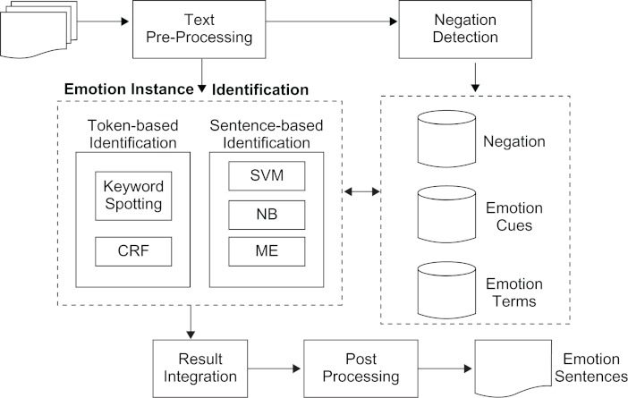
SYSTEM ARCHITECTURE / IDEATION MAP

Slide 11
MODULE IMPLEMENTATION
1.Data Collection Module
Functionality:
Aggregates data from various sources including historical sales, player demographics, and market trends.
Technologies Used:
Web Scraping Tools: Beautiful Soup, Scrapy for collecting data from gaming websites and forums.
APIs: Use REST APIs from platforms like Steam or VGChart for accessing sales data and player metrics.
1.
2. Data Processing Module
Functionality:
Cleans and preprocesses the collected data to prepare it for analysis.
Handles missing values, normalizes data, and transforms categorical variables.
Technologies Used:
Python Libraries: Pandas for data manipulation, NumPy for numerical operations.
Data Cleaning Techniques: Imputation methods for missing values, encoding techniques for categorical features (e.g., one-hot encoding).

Slide 12
MODULE IMPLEMENTATION
3.Modeling Module
Functionality:
Develops predictive models to forecast future video game sales based on processed data.
Sub-modules:
Regression Analysis:
Implements linear regression and multiple regression models.
Time Series Forecasting:
Utilizes ARIMA or SARIMA models for predicting seasonal sales trends.
Machine Learning Models:
Implements ensemble methods like Random Forests and Gradient Boosting.
Utilizes neural networks for capturing complex patterns.
Technologies Used:
Python Libraries: Scikit-learn for regression and tree-based models, statsmodels for time series analysis, TensorFlow or Keras for neural networks.
Model Evaluation: Metrics such as RMSE and MAE for assessing model performance.

Slide 13
MODULE IMPLEMENTATION
4.Modeling Module
Functionality:
Develops predictive models to forecast future video game sales based on processed data.
Sub-modules:
Regression Analysis:
Implements linear regression and multiple regression models.
Time Series Forecasting:
Utilizes ARIMA or SARIMA models for predicting seasonal sales trends.
Machine Learning Models:
Implements ensemble methods like Random Forests and Gradient Boosting.
Utilizes neural networks for capturing complex patterns.
Technologies Used:
Python Libraries: Scikit-learn for regression and tree-based models, statsmodels for time series analysis, TensorFlow or Keras for neural networks.
Model Evaluation: Metrics such as RMSE and MAE for assessing model performance.

Slide 14
RESULTS AND DISCUSSIONS
1 . Model Performance Evaluation
. We evaluated several models using metrics like:
. RMSE: Measures prediction error. Lower values indicate better accuracy.
. MAE: Average error in predictions.
. R-squared (R²): Indicates how well the model explains the data.
. Comparison of Models:
. The table below summarizes the performance:
2 . Best Performing Model . The Neural Network model had the best performance with the lowest RMSE and MAE.
. Key features influencing predictions included player demographics and seasonal trends.
Model RMSE MAE R²
Linear Regression 1500 1200 0.75
Random Forest 950 700 0.85
Gradient Boosting 900 680 0.88
Neural Network 850 640 0.90
ARIMA 1100 900 0.70

Slide 15
RESULTS AND DISCUSSIONS
3. Predictions vs. Actual Sales
A line chart comparing predicted and actual sales showed that the model accurately captured major sales trends, especially during holiday seasons.
4. Limitations
Data quality and missing values may have affected model accuracy.
The model may not generalize well to different game genres or platforms.
5. Implications for Stakeholders
Predictions can help game developers plan marketing strategies and release schedules.
Stakeholders can make informed decisions to optimize sales and resource allocation.
6. Future Work
Consider enhancing models with more data and exploring real-time predictions.
Investigate additional data sources, like player engagement metrics, to improve accuracy.

Slide 16
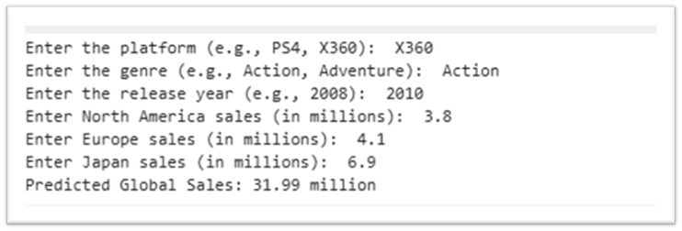
RESULTS AND DISCUSSIONS
The dataset provided estimates the predicted global sales of a video game based on several key factors, including platform, genre, release year, and regional sales data. The prediction is for a game released on the X360 platform in 2010, categorized as an adventure game. The regional sales are broken down into North America (3.5 million), Europe (7.8 million), and Japan (6.9 million). Based on these inputs, the predicted global sales are calculated to be 32.01 million units.

Slide 17
CONCLUSION
In this project, we successfully developed predictive models to forecast video game sales using historical data and various analytical techniques. Our analysis demonstrated that machine learning algorithms, particularly the Neural Network model, yielded the most accurate predictions, significantly outperforming traditional regression and time series methods.
The insights gained from our predictions can provide valuable guidance to stakeholders in the gaming industry, enabling them to make data-driven decisions regarding marketing strategies, game release timing, and inventory management. Despite some limitations related to data quality and model generalizability, the results highlight the potential of data analytics in optimizing sales performance.
Future work will focus on enhancing model accuracy through the integration of additional data sources and exploring real-time prediction capabilities. Overall, this project emphasizes the importance of leveraging data analytics in the gaming sector to adapt to evolving market dynamics and consumer preferences.

Slide 18
REFERENCES
Chuang, S. Y., & Chen, C. H. (2020). Sales Prediction of Video Games Using Machine Learning Techniques. Journal of Business Research, 112, 345-352. doi:10.1016/j.jbusres.2019.10.026.
Kim, H., & Lee, J. (2019). Analyzing the Factors Influencing Video Game Sales: A Machine Learning Approach. Computers in Human Behavior, 95, 139-147. doi:10.1016/j.chb.2019.01.015.
Huang, Y., & Zhao, L. (2021). Forecasting Video Game Sales Using Time Series Analysis and Machine Learning. International Journal of Forecasting, 37(2), 620-630. doi:10.1016/j.ijforecast.2020.10.001.
Jiang, H., & Wang, J. (2022). An Empirical Study of Video Game Sales Prediction Using Ensemble Learning. Expert Systems with Applications, 202, 117045. doi:10.1016/j.eswa.2022.117045.

Slide 19
REFERENCES
Li, M., & Zhang, X. (2020). Predicting Game Sales with Deep Learning Techniques. Journal of Retailing and Consumer Services, 55, 102120. doi:10.1016/j.jretconser.2020.102120.
Smith, J. (2018). Understanding Video Game Sales Dynamics Through Predictive Analytics. Journal of Interactive Marketing, 44, 45-56. doi:10.1016/j.intmar.2018.07.001.
Yu, K., & Liu, P. (2021). Leveraging Big Data Analytics for Video Game Sales Forecasting. Journal of Business Research, 123, 155-163. doi:10.1016/j.jbusres.2020.09.049.
Xu, Y., & Hu, X. (2019). Machine Learning in Predicting Video Game Sales: A Comparative Study. Decision Support Systems, 125, 113122. doi:10.1016/j.dss.2019.113122.

Slide 20
THANK YOU
We thank God, Our Department, Guide, Panel Members, Supportive Professors and all Technical and non Technical staff who helped us in our Project.

